Slide 1




Slide 2


Slide 3

Thank you for promoting the conversation about mental health and wellness through the use of Gizmo’s Pawesome Guide to Mental Health Curriculum. This program uses the friendly face of therapy dog Gizmo and his friends to introduce youth to mental health, teach coping strategies and guide relationship-building with trusted adults.
For consultation, guidance, training information, or a copy of our evaluation report on Gizmo’s Pawesome Guide to Mental Health Elementary Curriculum ( 2020), please do not hesitate to Contact Us at: https://www.gizmo4mentalhealth.org/contact/

Slide 4

Gizmo’s Pawesome Guide to Mental Health was developed to introduce mental health and wellness knowledge and skills to youth at an early age with the hope that they may keep and apply what they learn for a lifetime to help them stay healthy and safe.
This curriculum is flexible and uses activities that we anticipate will help children, their trusted adults, and the settings in which they live support their mental health and create a greater sense of individual and community connectedness.
The intended knowledge and skills gain includes:
  1. What is mental health;
  2. Mental health is equally as important as physical health;
  3. Daily activities that support mental health wellness;
  4. How to identify when mental health needs attention;
  5. Internal and external healthy coping strategies that support mental health;
  6. How to identify and connect with trusted adults; and
  7. Resources to share with trusted adults.
Rationale
Preparation
Implementation

Slide 5

The curriculum, much like the book, is evidence-informed and data-driven.
  The mental health plan included in the book is informed by the Stanley and Brown Safety Plan which helps to prepare coping strategies and resources for times of crisis. (http://suicidesafetyplan.com/)
  The curriculum’s emphasis on the identification of trusted adults is guided by the fact that in 2015, in Connecticut, 33% of high school students report that there is not at least one teacher or other adult in their school that they can talk to if they have a problem.
  Identifying and contacting trusted adults at a young age aims to help children build relationships with positive role models that will continue into high school and beyond.
  (http://portal.ct.gov/dph/Health-Information-Systems--Reporting/Hisrhome/Connecticut-School-Health-Survey%20

Slide 6

Preparation prior to implementing the curriculum is essential and is detailed in the following slides.
  Logistics
  Role assignment
  Materials
  Gatekeeper training
    Mental Health or Suicide Prevention (e.g. Youth Mental Health First Aid, Question Persuade Refer, Talk Saves Lives, More Than Sad, safeTALK)
    https://www.gizmo4mentalhealth.org/curriculum-preview/

Slide 7
Which class or group will participate?
  There should also be a plan for children within the class/group that for any reason will not be participating.
Will the curriculum occur in one time-block or over the course of multiple days?
  The curriculum is created to be presented in one session or over the course of multiple days. If done across multiple days, it is suggested that there is no longer than 2 weeks between each session.
What will the setting be?
  It is recommended that the curriculum be implemented in a group no larger than 25 children, at least one adult/staff member, and with the group seated in a circle. The implementer should be seated within the circle, not in the front of the room.
  If conducted in one session, this curriculum should not be completed on a Friday or immediately before a school break.
  If conducted in multiple sessions, this curriculum should be broken up at the points indicated in the guide. Multiple segments can be completed together if time permits do not stop-mid segment.
  This curriculum is a progression and must be completed in the order it is presented to ensure fidelity.

Slide 8
Additional adults may include paraprofessionals, volunteer parents, identified trusted adults, school/agency staff, administrators, community based support (youth mobile crisis, child guidance clinic staff).
Indicated trusted adults should ideally be counseling staff at school/agency who are consistently present (not sharing time with other institutions).
School/agency counseling staff should be conducting follow-up support. To support continuity of support, we suggest having the last two bullet points be the same person(s).
Assign roles to the staff/volunteers involved
  Who will implement the curriculum? Will there be additional staff in the room for support?
  Who will perform evaluation tasks at implementation site?
  Which school/agency-indicated trusted adults will be present during session time(s)?
  Who will be responsible for meeting with children who request follow-up?

Slide 9
Materials
  Following this orientation, you will need to review and print various materials prior to implementing the curriculum:
    Review: School/agency policies and procedures regarding mental health and crisis management must be reviewed/updated when necessary. These are importance resources that must be current and comprehensive.
    Print: Some curriculum materials will be available online and can be printed or downloaded.
    (www.gizmo4mentalhealth.org)
It is imperative that your site’s policies and procedures for responding to youth in crisis are up to date and include suicide prevention specifically. For more information and assistance, please visit the 1 Word, 1 Voice, 1 Life website: www.preventsuicidect.org

Slide 10
In addition to the review and enhancement of school/agency policies and procedures, Gatekeeper training for all school/agency staff is essential to prepare for curriculum implementation. This training equips gatekeeping staff with the knowledge and skills to identify and assist children and adults who may be at risk.
  Examples: Youth Mental Health First Aid, Question Persuade Refer, Talk Saves Lives, More Than Sad, safeTALK)
  For more information, go to “Prior to Curriculum Implementation” section: https://www.gizmo4mentalhealth.org/curriculum-preview/

Slide 11

The following slides include a page-by-page guide for curriculum implementation.
  This guide includes discussion questions. The wording can be modified if necessary for age-appropriate comprehension.
  The curriculum contains optional and required activities. Please note: since the required activities are essential to maintain the evaluated fidelity of the components, they should be completed as directed.
  There are indicators for stopping points if the curriculum is being implemented over multiple days.

Slide 12

Page 1: Read page
Discussion questions:
  Has anyone met a therapy dog before? Can you tell me about him/her?
Page 2: Read page
Page 3: Read page
Page 4: Read page
Discussion questions:
  Does everybody understand what mental health is?

Slide 13








Slide 14



Slide 15





Slide 16





Slide 17
Page 5: Read page
Page 6: Read page
  In the slideshow, this page will present without the examples displayed inside the dog bowl. After having a discussion with the children about what they think are some examples of ways to take care of their mental health, move to the next slide where the ideas from the book will fly into place.
Page 7: Review photo page
Page 8: Read page with continued examples for discussion

Slide 18




Slide 19





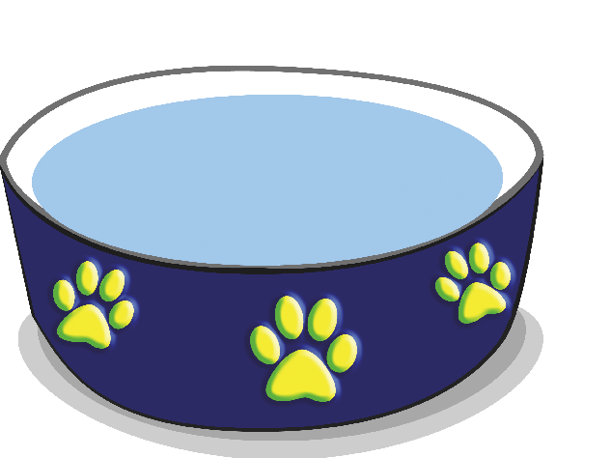


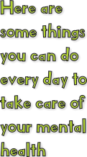
It is important that implementers are prepared to respond to potentially “inappropriate” responses, and redirect/guide children as needed.

Slide 20









Slide 21









Slide 22

Page 9: Review photo page
Optional Activity:
  Pass out the laminated, reusable GIZMO (BINGO) cards. The cards feature visual representations of the examples provided. The activity then follows the classic rules of BINGO. The curriculum toolkit includes Gizmo stickers that can be used as prizes for winner(s).
END OF SEGMENT 1
(Stop here if using multiple sessions. Continue if using one session.)
    Please visit the 1 Word, 1 Voice, 1 Life website for materials free-of-charge. They make great gifts for GIZMO winners: www.preventsuicidect.org

Slide 23
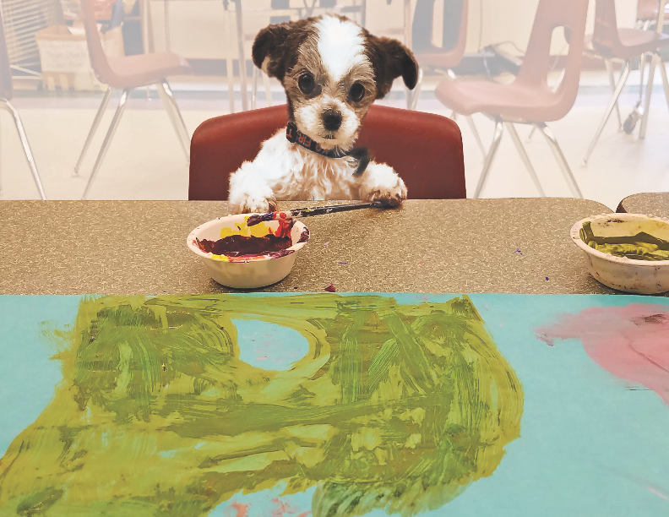









Slide 24








